Slide 1




Types of Nouns
Person
Place
English, Grammar Review
Thing
Idea

Slide 2

Types of Nouns
Common/ Proper
Abstract/ Concrete
Collective
Human/ Non-Human
Plural/ Singular
A noun will always be a person, place, thing or idea!

Slide 3
Common/ Proper Nouns
A common noun is a general name for a person, place, thing or idea.
Example- theater
A proper noun is a name of a specific person, place, thing or idea.
Example- Palace Theater
Only proper nouns need to be capitalized, so a big clue is if the noun is capitalized.

Slide 4
Concrete Nouns
These nouns are the ones we can visualize. Examples: Table, Rock, Flag, Hairdresser
…you can SEE
…you can TOUCH
…you can TASTE
…you can HEAR
… you can SMELL

Slide 5
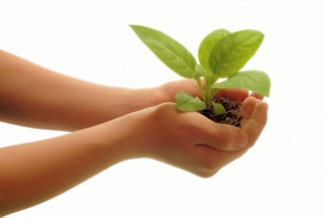
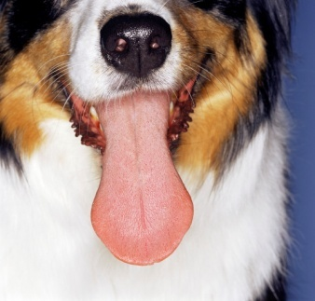
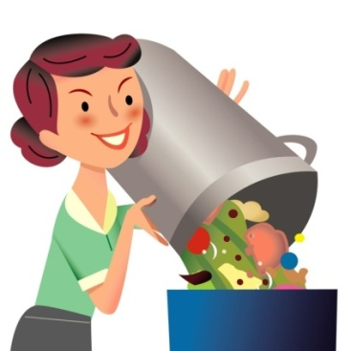

Concrete Nouns have
Sight, Touch, Hear, Smell, Taste
Leaves- Touch
Disturbance- Hear
Sour- Taste
Stench- Smell
Smoke- Sight

Slide 6
Abstract Nouns
These nouns are usually ideas or concepts with no clear visual image.
…Ideas
…Thoughts
…Feelings/ Emotions
…Concepts
Examples- Sincerity, Anger, Happiness, Hope, Love, Intelligence

Slide 7

Think of an image for HOPE
Everyone has a different image in mind!
These abstract nouns can only be described and imagined.
This is why abstract nouns often have symbols to show meaning.

Slide 8


Human/ Non-Human Nouns
Human…boys
…girls
Non-human…
…animals
…nature
…objects

Slide 9
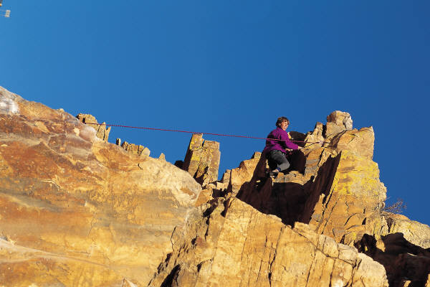
Choosing between human and non-human nouns is important when talking about a noun in a sentence.
The rock smiled.
WRONG!
The boy smiled.
Who is making that noise? (A person)
What is making that noise? (Something nonhuman!)

Slide 10
Human/ Non-Human Nouns
A good test to decide if a noun is human or non-human is to ask…
Is the noun alive?
Could I do this?
Could a rock do this?

Slide 11

Collective Nouns
Collective nouns name a group of people or things.
Examples- crew, cast, audience, class, committee

Slide 12
Plural/ Singular
Singular | Rule | Plural
boy, girls | Add -s | boys, girls
echo, hero | Add –s to a few -o endings | echoes, heroes
box, church | Add –es to -s, -sh,-ch, -x, -z endings | boxes, churches
melody, fly monkey, day | Change –y to –i and add -es to –y endings. If a vowel comes before the -y, add –s. | melodies, flies monkeys, days
thief, half roof, cuff | Change –f to –v, add –es to most. Add –s to a few –f endings | thieves, halves roofs, cuffs
corn, tuna, fish | Same spelling | corn, tuna, fish
woman, foot | Irregular plural forms | women, feet

Slide 13
Nouns that fit who you are!
Proper noun:Ms. Martin
common noun: teacher
abstract noun: creativity
singular noun: Oklahoman
concrete noun: female
Plural noun: opportunties

Slide 14
Make your own to describe you!
Proper Noun
common noun
abstract noun
singular noun
concrete noun
Plural noun

